Slide 1
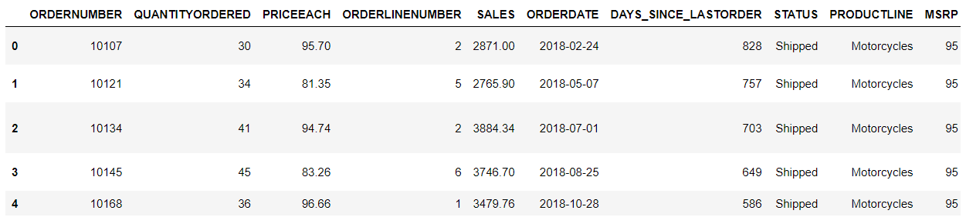
Executive Summary of the data:
Problem statement:
3 years transaction data of an automobile parts manufacturing company. We need to analyze their data and provide suitable insights and recommend customized marketing strategies for different segments of customers.
Data Summary:
We are given 20 parameters for each transaction and a total of 2747 transactions are given.
We first analyze the data in Anaconda using python and the head of the data with the first few rows and columns looks like this:
We then use the describe function to have a look at the summary statistics of the data:

Slide 2
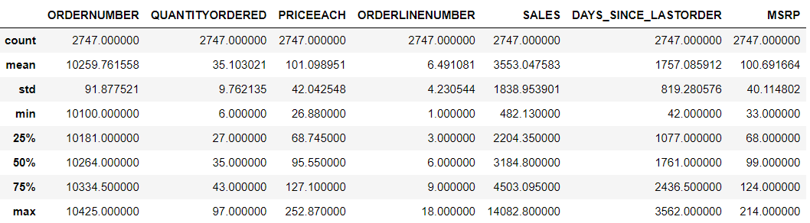
The average quantity ordered per order is 35. The data for this is symmetric on both sides.
The average price of each item is 101. Even here the data is symmetric on its mean.
The average sale that the customer receives is 3553. We observe a lot of left skewness in the distribution of this variable.
The average number of days since the last order of the customer is 1757.
The variables: Ordernumber, Quantityordered, Priceeach, Sales, Orderdate, Productline, Status, Productode, Customername, City, Country, Dealsize is most important for our analysis.
The variables: Phone, Addressline1, Postalcode, Contactlastname, Contactfirstname are supposed to be useful after the initial analysis is done and the particular customer needs to be contacted for maximizing revenue to the automobile parts manufacturer.
We also check for missing or null values in the data using the isnull function in python and see that there are none available:

Slide 3
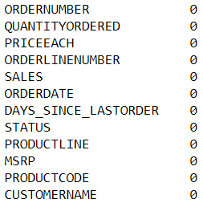
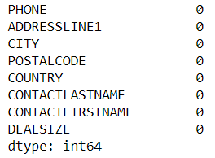
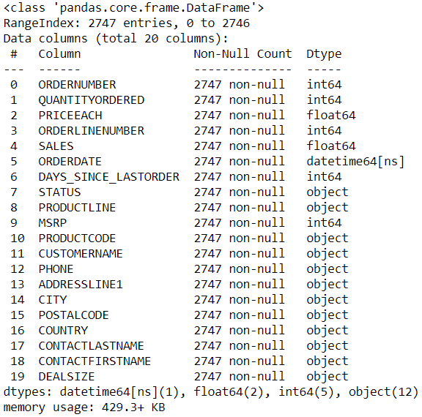
We also look at the info of the data to see if the data types have been imported correctly.
The orderdate has been imported as a datetime data type.
We also check the individual value counts of the columns in python and see that there aren’t any data anomaly. The results of the value count will be shared in the python file for you to review if required and will be presented along with the contents of this presentation.

Slide 4
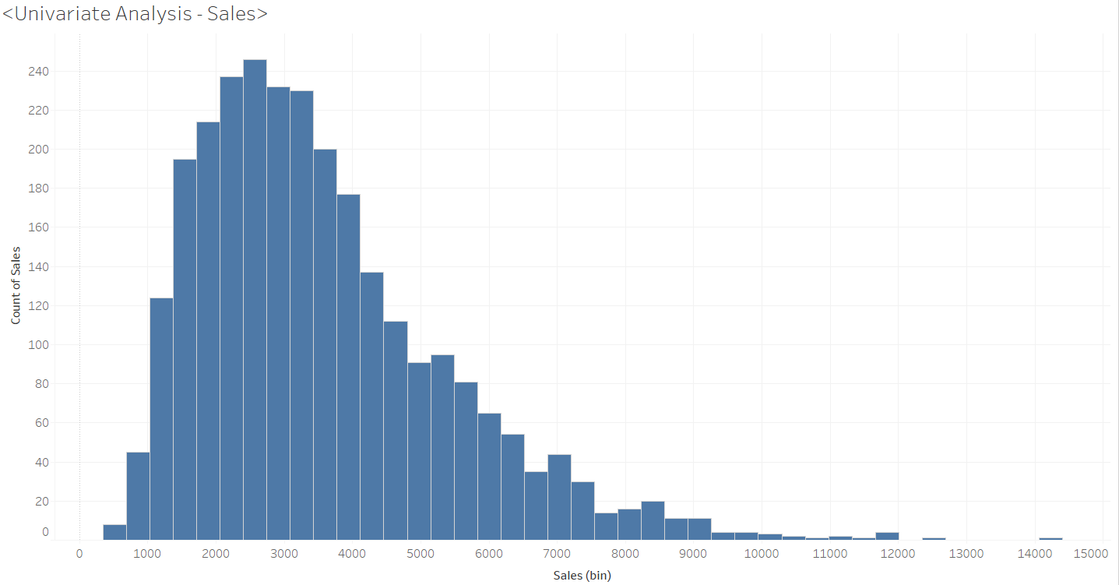
Exploratory Data Analysis using Tableau: We use Tableau for performing Exploratory Data Analysis.
Univariate Analysis: Sales
Right skewed distribution, Highest sale frequency in the range of 2500, many outliers present with a very high sale value but with a low sale frequency.

Slide 5
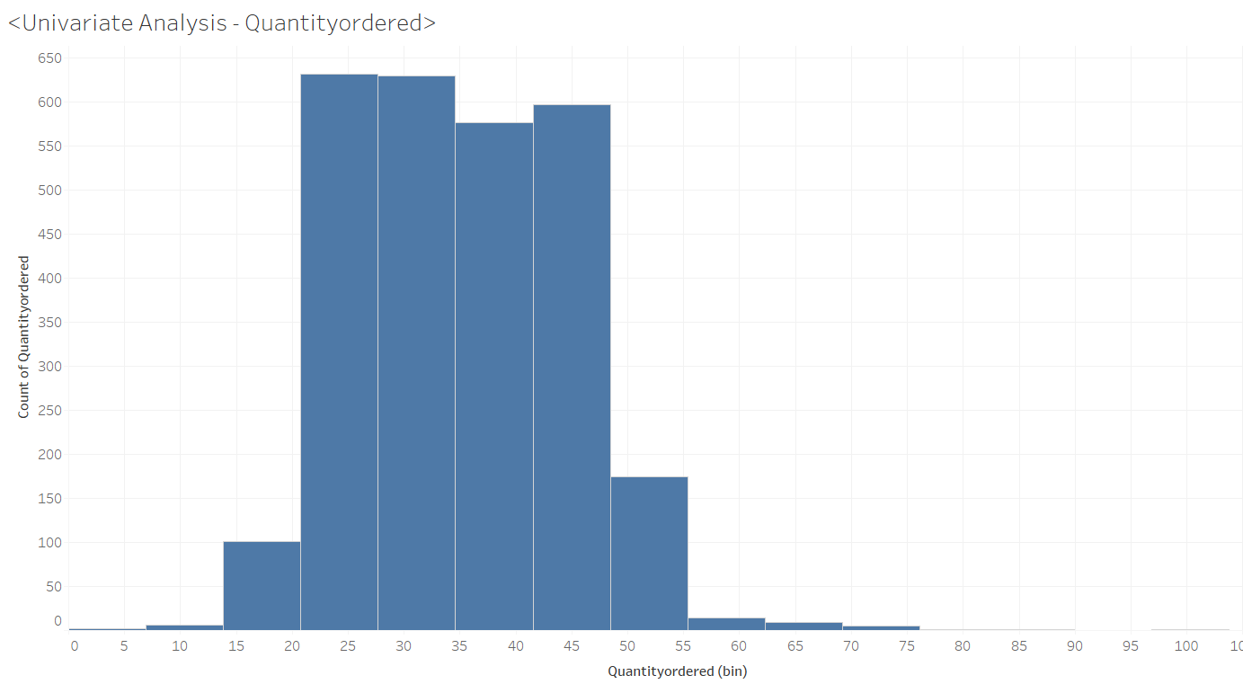
Univariate Analysis: Quantity Ordered
The sum of quantity ordered is mainly comprised of high frequency quantities between the range 20 – 50 units.
Higher order quantities are present but with a low order frequency.

Slide 6
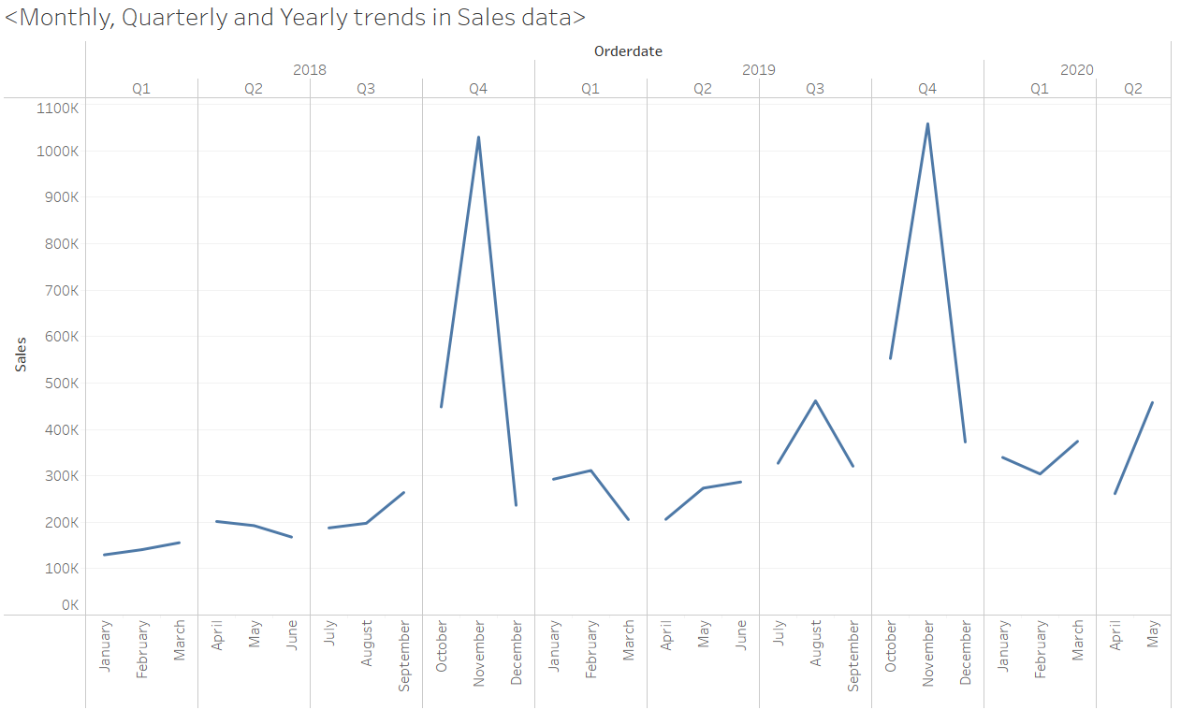
Bivariate Analysis: Order date split into quarterly data with Sum of Sales
We see a strong sales trend in the fourth quarter of each year. There is a steep increase in sales from October and peaks in November, post which we see a steep downfall by December. This seasonal component needs to be closely analyzed to spot contributing factors.
We also notice an overall increase of sales for the Automobile parts manufacturer over the years. We see that the average sum of sales for the year 2018 was 3518, for the year 2019 it was 3513 and for the first one and a half quarters of 2020 it was 3736.

Slide 7
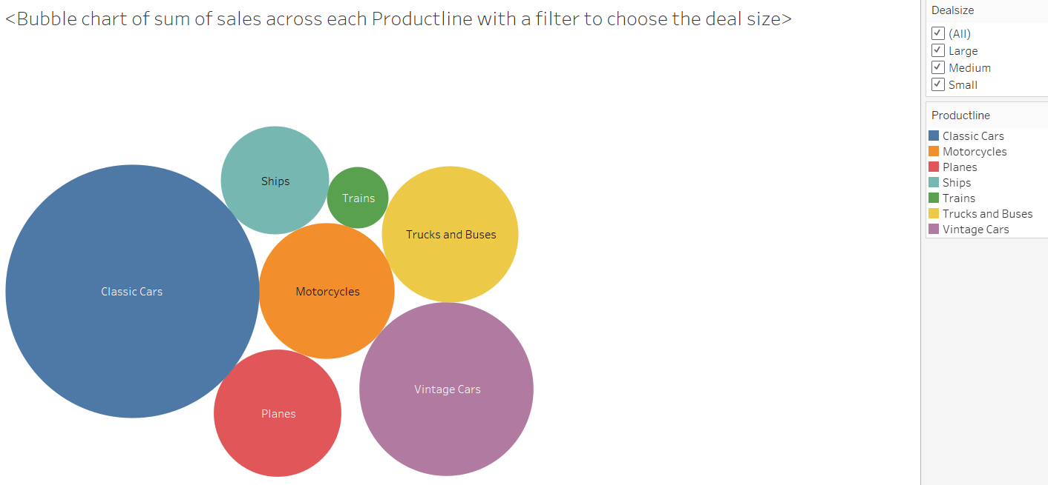
Multivariate Analysis: Bubble chart of sum of sales across each Productline with a filter to choose the deal size
We see that the Productline with the Classic Cars have the highest sum of sales as compared to any other Productline.
Vintage cars are the next category in the Productline which claim the second highest sum of sales. Trucks and Buses and Motorcycles are next in line with an almost equal portion of sum of sales.

Slide 8
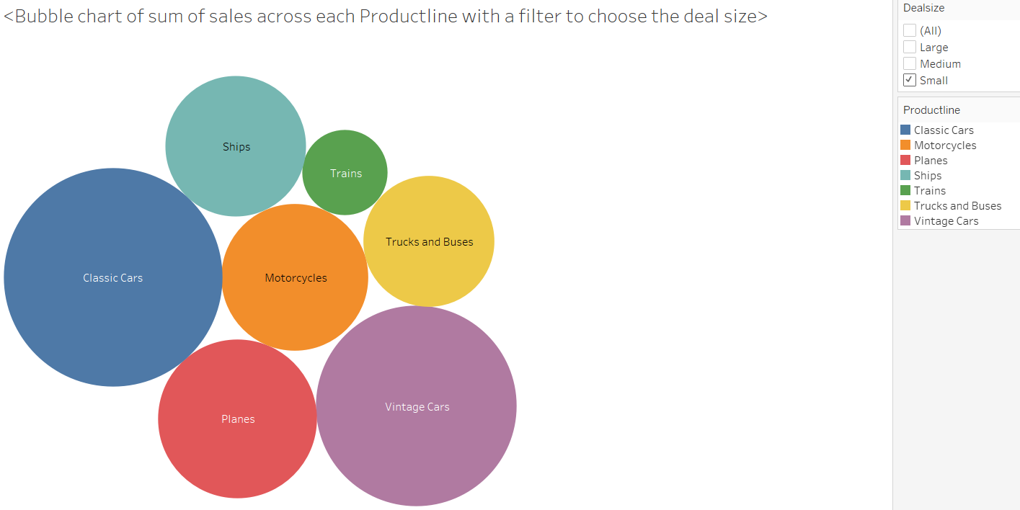
Here we have a filter to choose the deal size as Small. In the deal size of small, we are able to see that the sum of sales for the Vintage cars is almost same or slightly bigger than that of the Classic cars. The contribution of Plans, Motorcycles, Trucks and Buses, Ships and Trains have also increased noticeably.

Slide 9
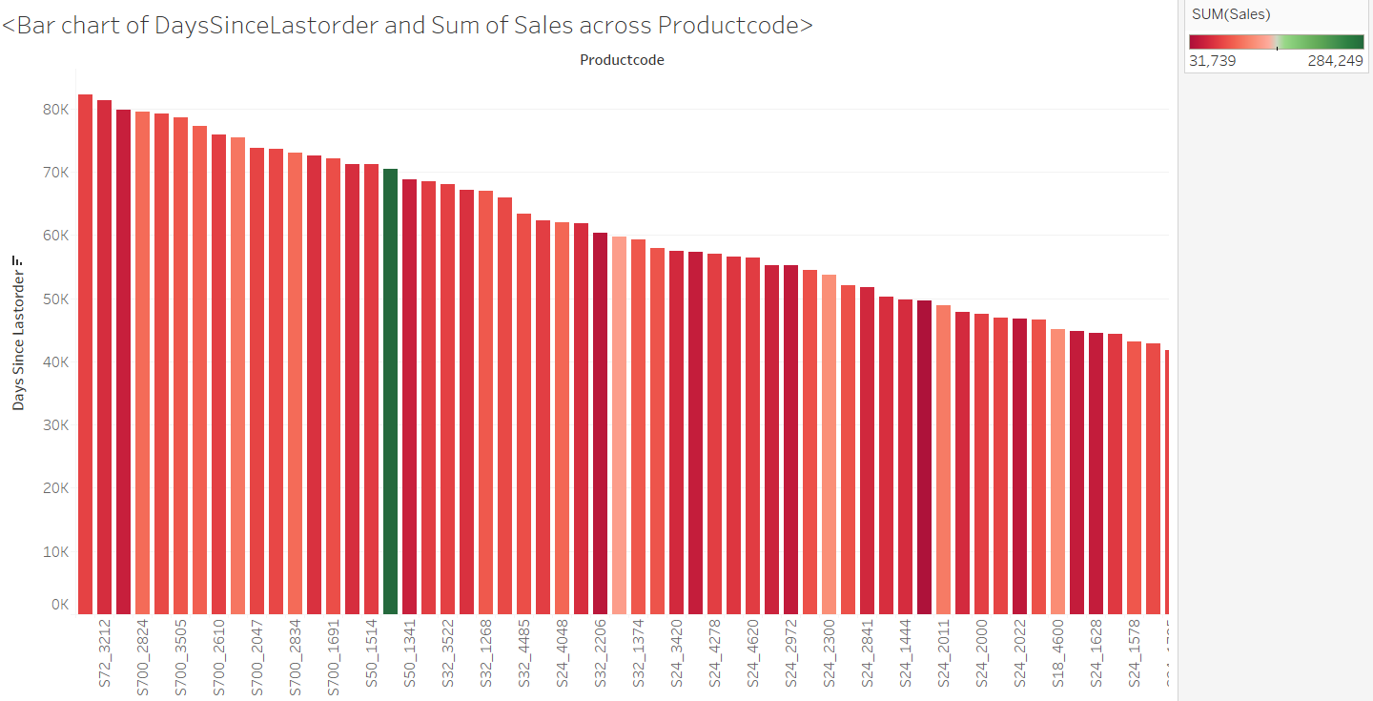
Bar chart of DaysSinceLastorder and Sum of Sales across Productcode
Here we see that the product code: S18_3232 is the one with the highest sum of sales.
The product code: S700_4002 is the one that has the highest number of days since its last order.

Slide 10
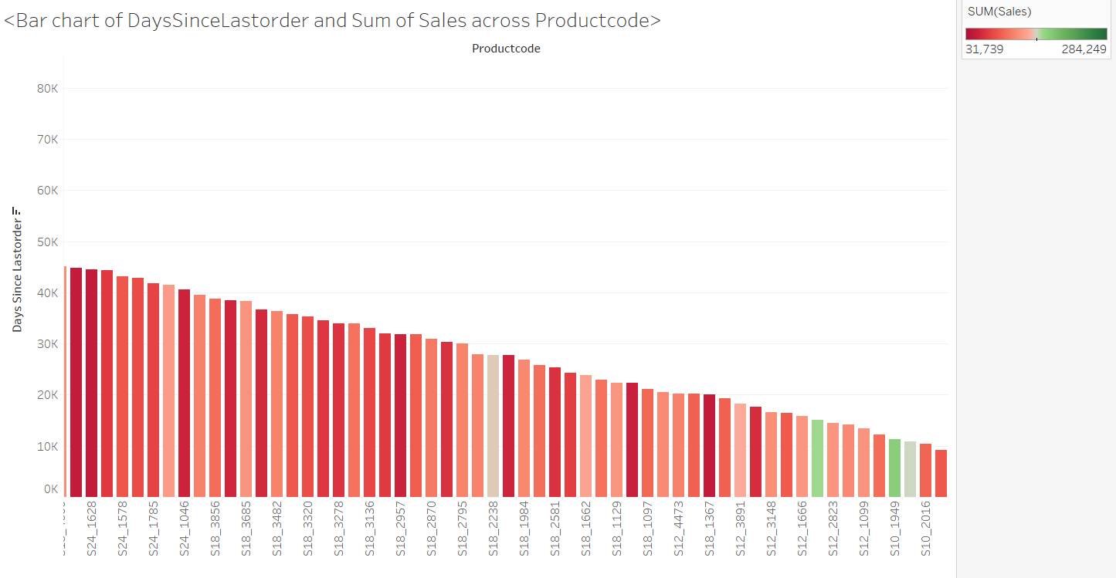
Here we see the products that have a low DaysSinceLastorder. It is interesting to note that the product codes: S10-1949 and S12_1108 also have a very high sum of sales. These are our top selling products in terms of sum of sales.

Slide 11
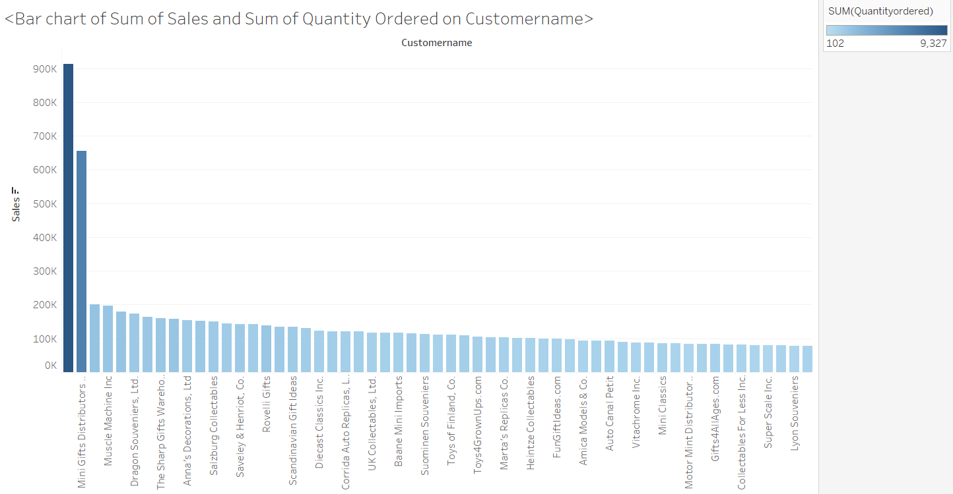
Bar chart of Sum of Sales and Sum of Quantity Ordered on Customername
Euro Shopping Channel and Mini Gifts Distributors Ltd. are the top two customers with a very high sum of sales.
It is to also note that Euro Shopping Channel is the Customername that has a very high sum of Quantityordered.

Slide 12
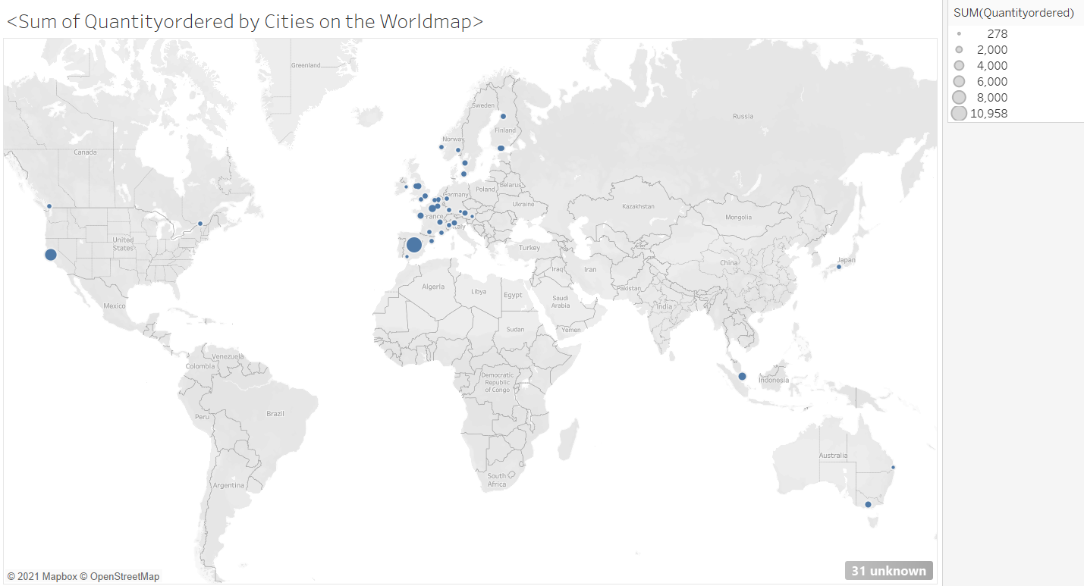
Sum of Quantityordered by Cities on the Worldmap
Based on the sum of Quantityordered, the highest is from the City: Madrid with an order quantity of close to 11,000.
San Rafael from USA is the city with the second highest sum of Quantityordered with 6366 order quantity.

Slide 13
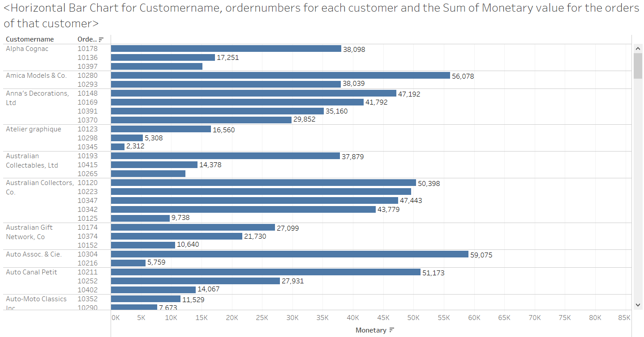
Horizontal Bar Chart for Customername, ordernumbers for each customer and the Sum of Monetary value for the orders of that customer
The monetary value is computed as the product of the quantity ordered and the price each. This is computed for each order placed by the customer.
The data is sorted in the descending order of the monetary value for each customer.

Slide 14
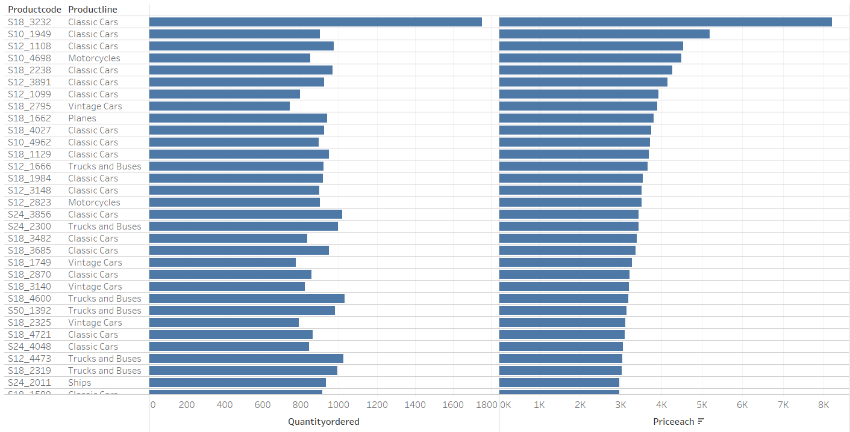
Horizontal bar chart for Sum of Quantityordered and sum of Priceeach across Productcode and Productline
The Product line: Classic Cars and the product code S18_3232 have the highest order quantity and have the highest Priceeach.
Although Vintage Cars with the productcode: S24_3969 have the orders with the lowest priceeach, they sure have a considerable Quantityordered.

Slide 15
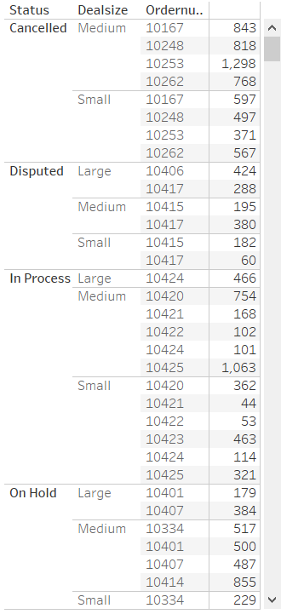
Horizontal Bar Chart for Sum of MSRP for data sorted based on Status, Dealsize, Order number
The orders have been sorted based on the Status of the orders.
The orders with the status cancelled do not bring revenue to the Automobile parts manufacturer.
The orders in the status: Disputed and On Hold are orders that are on the line. We do not know if these orders will progress. Income to the company from orders of these statuses also have a question mark.
It is a bit relieving for the Automobile parts manufacturer to know that no orders with the Dealsize as Large have been cancelled.

Slide 16
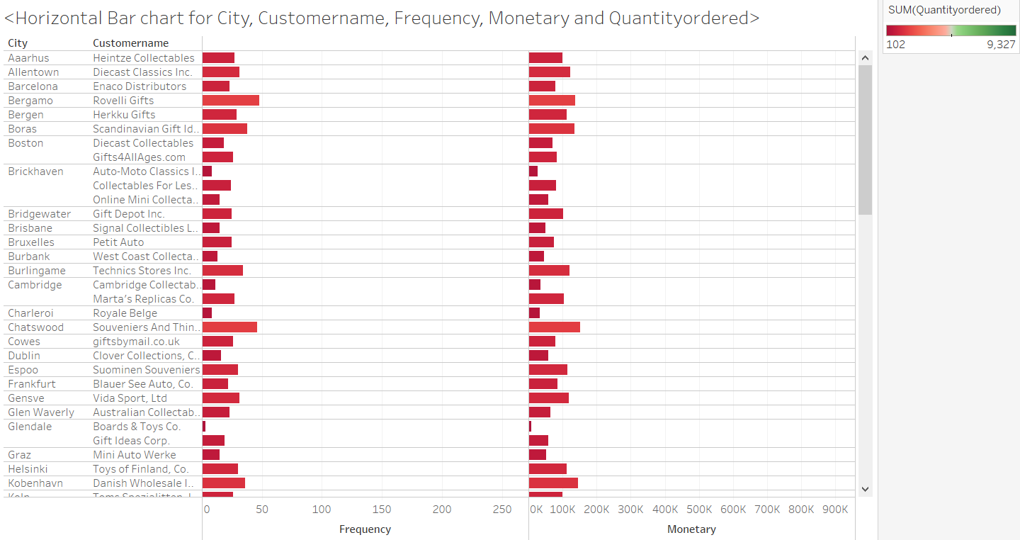
Horizontal Bar chart for City, Customername, Frequency, Monetary and Quantityordered
Almost all the customers except a few have a low Monetary value, a low Frequency and a low Quantityordered.
Popular Cities like NYC have a high number of customers as compared to the less popular ones like Bergen.
The Quantityordered, Frequency and Monetary are high for the customers: Mini Gifts Distribution Ltd. & Euro Shopping Channel.

Slide 17
RFM Analysis using KNIME:
RFM – Recency, Frequency and Monetary have been computed with the following formulae:
Recency : Orderdate – 25.7.2021 in days.
Frequency : Count of Ordernumber.
Monetary : Product of Priceeach and Quantityordered. Note: The MSRP has not been taken here as it is observed to be less than the Priceeach and hence we assumed the MSRP to not have factored the company profits.
The data is then grouped by the Customername field and the values are aggregated as follows:
Ordernumber and Orderlinenumber as Unique count, Quantityordered, Sales and Priceeach as Mean, Orderdate as count, Status, Productline, Productcode, City, Country, Dealsize as First, Monetary as Sum and Recency as Minimum.
For the variables: Monetary and Frequency we have used the Autobinner node in KNIME to bin the customers into Bin 1, Bin 2 and Bin 3 with each representing the respective quantiles 0 – 0.25, 0.25 – 0.75, 0.75 – 1.
For the variable: Recency, we have considered the bins in the reverse order as the most recent customers (Customers with a low Recency number) are regarded as Highly valuable.
We have then used the table creator node to introduce the three segments High, Medium and Low.
The Cell replacer replaces the Monetary and Frequency Bin 1, Bin 2 and the Bin 3 with the bins Low, Medium and High respectively.
Then the final data is then exported into an Excel file: RFM_output using the Excel Writer node for further analysis.

Slide 18
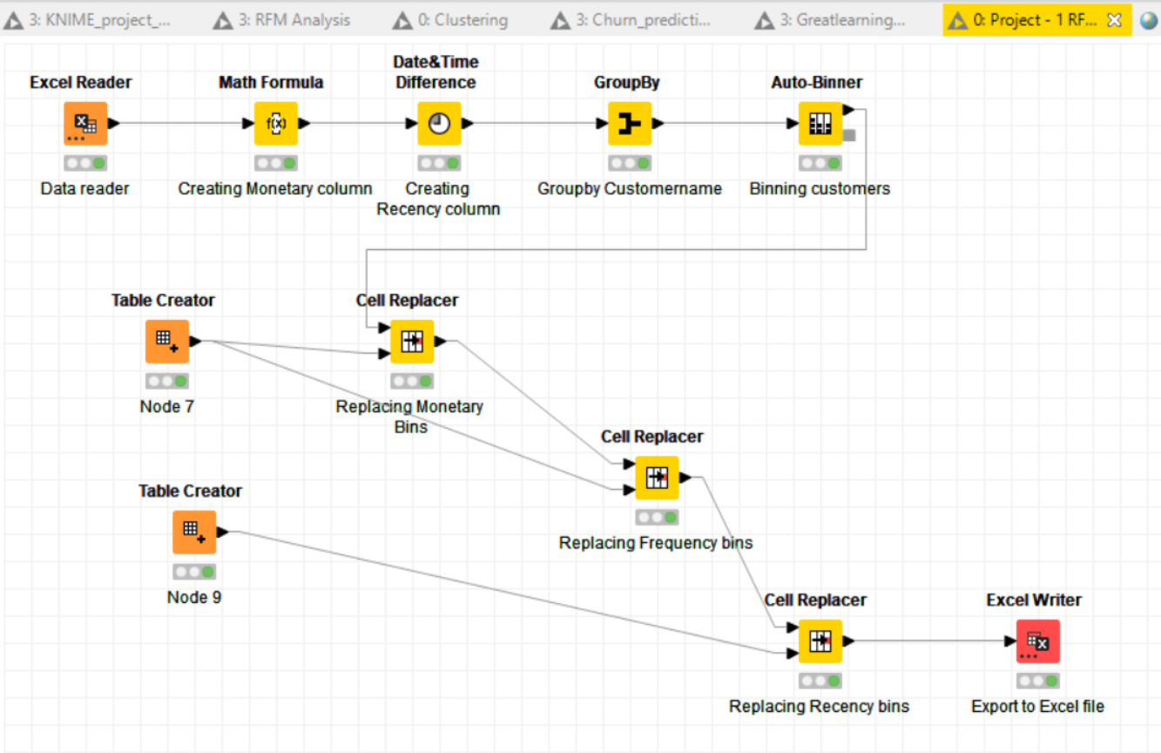
KNIME Workflow diagram:

Slide 19
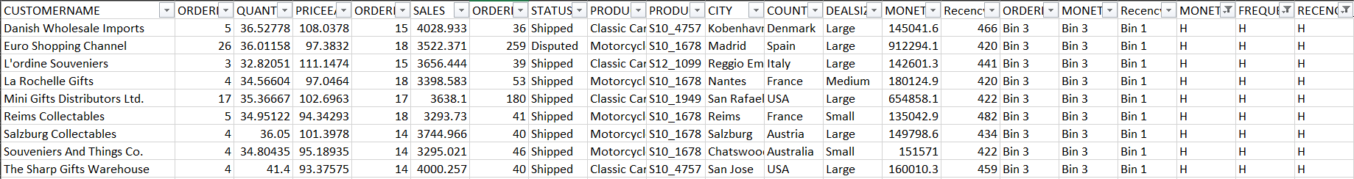
RFM Inferences and Identified Segments:
The Tier – 1 customers: Customers who have a high Recency, high Frequency and a high Monetary value.
We have 9 customers as listed below who are the top of the customers for the automobile parts manufacturing company.
The Product code: S10_1678 is the product that most of these customers have ordered.
The average sum of monetary value that these customers have brought to the automobile parts manufacturer is 292371.
The last time these customers came was around 440 days ago on an average.
The average quantity ordered among these customers is 35.83 and the average sale that these customers give me each time they come is 3619.82.
The product line of these customers are Classic Cars and Motorcycles.
Mini Gifts Distributors Ltd. & Euro Shopping Channel are the exceptionally profitable customers to the automobile parts manufacturing company. We need to cater to these customers in a special way as these are the customer because of which the Automobile company is making profits.

Slide 20
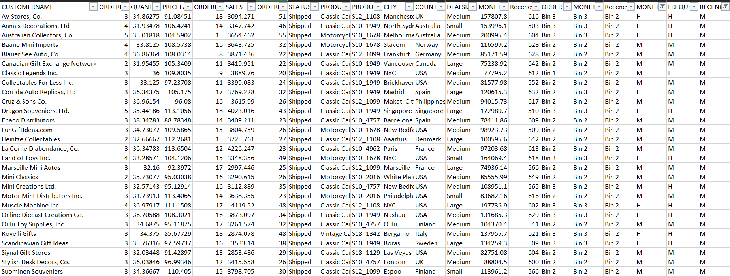
Tier 2 Customers:

Slide 21
These are customers with a Medium Recency, High or Medium Frequency, High or Medium Monetary value.
These customers have come to the automobile parts manufacturer about 31.57 times on an average, the average Quantityordered is 34.62.
These customers give me an average sale of 3546, the average sum of Monetary value that these customers have given the automobile parts manufacturer is 111417.
These are second in list of top customers.
The last time these customers came to the automobile company was on an average 592 days ago.
These customers need to be motivated to have a business transaction with the Automobile parts manufacturer ASAP.

Slide 22
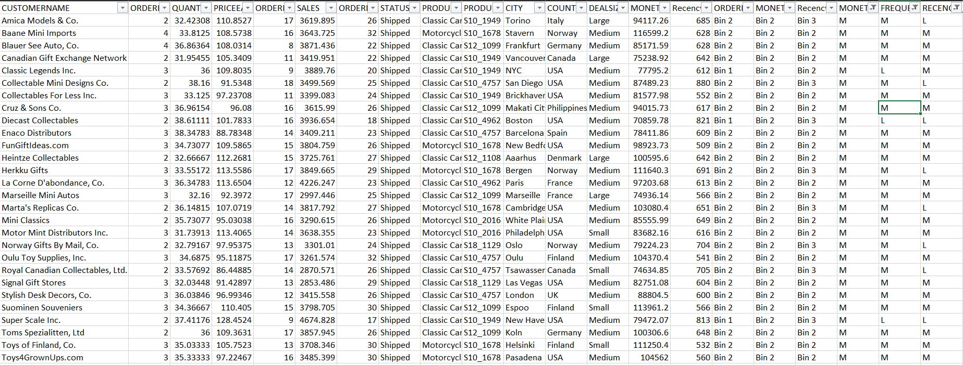
Tier 3 Customers:

Slide 23
These are the customers with a medium or low Recency. They have a medium or low Frequency and they have a medium Monetary value.
These customers have transacted with me just about 2.68 times on an average, have an order quantity of 34.72 on an average and each time they come they give me an average sale of 3599.95.
The sum of Monetary value on an average by a customer in this category is 91124.44.
These customers have approximately transacted with the automobile parts manufacturer about 639 days ago on an average.

Slide 24
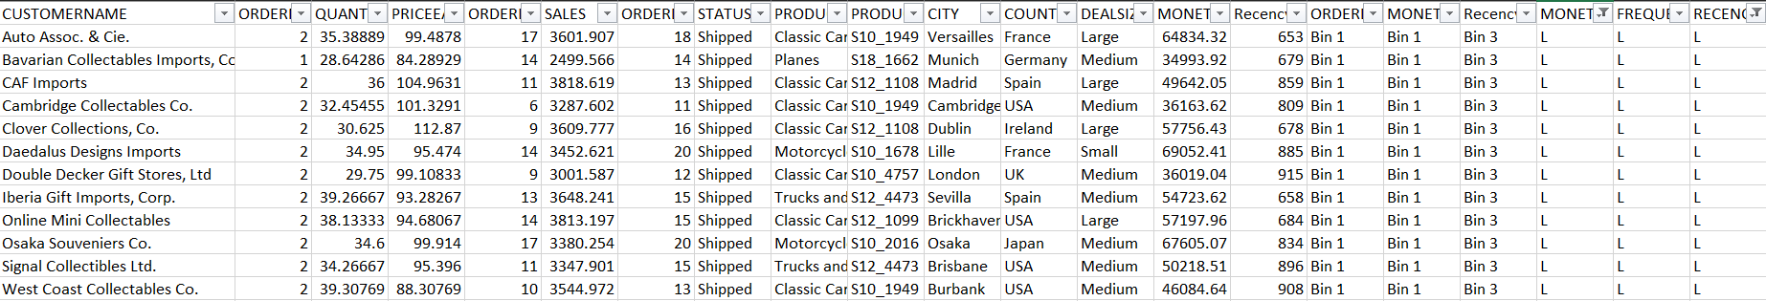
Tier 4 Customers:
These are the customers that have a low Recency, Low Frequency and a Low Monetary value.
These customers are not as profitable to the company as the previous group owing to their respective categories.
These customers can be let go off by the Autmobile parts manufacturer.
The funds allocated to entice the customers should never be spent on these customers.
The average sum of monetary value that these customers have given to the Automobile parts manufacturer is 52024.
These customers have transacted with the Automobile parts manufacturer only 15 times on an average.
The previous time these customers came to me was about 788 days ago on an average.
The average sale given by these customers each time they come to the Automobile parts manufacturer is 3417.18

Slide 25
Summary points:
The period between October and November of each year is the highest sales period. Adequete staffing, hike of price of each part sold and increased delivery speed can be some of the measures adopted during this period to cater to the high demand.
Best customers for the Automobile parts manufacturer are the customers listed in Tier – 1.
Customers listed on the Tier- 2 list are the customers that are on the verge of churning as aggressive promotional strategies are to be employed to lure them ASAP into placing an order.
Lost customers are the ones listed as the Tier – 4 customers.
Loyal customers are the ones listed in the Tier – 1 and 2 and 3 in the order of preference.

